Slide 1
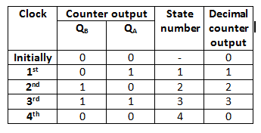
Counters
A special type of sequential circuit used to count the pulse is known as a counter, or a collection of flip flops where the clock signal is applied is known as counters.
Counters are of 3 types, namely:
Asynchronous/synchronous
Single and Multi-mode
Modulus counter.

Slide 2
Counters
Synchronous
Different FF triggered with different clock.
Faster
Not produce decoding errors.
Also called parallel counter
Variable count sequence
Ex: Ring counter, Johnson counter
Low propagation delay
Asynchronous
All FF are triggered with same clock simultaneously.
Slower
Produce decoding errors
Also called serial counter
Fixed count sequence
Ex: Ripple, Up/Down counter
High propagation delay

Slide 3
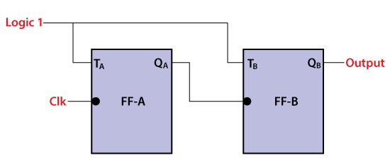
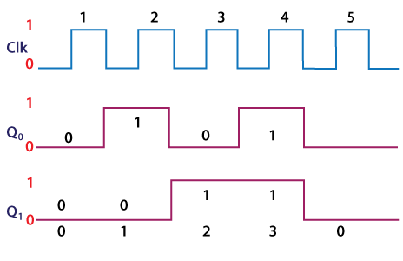
Asynchronous counter
The Asynchronous counter is also known as the ripple counter.
Ex 2-bit Asynchronous counter in which we used two T flip-flops. The external clock pass to the clock input of the first flip flop, i.e., FF-A and its output, i.e., is passed to clock input of the next flip flop, i.e., FF-B.

Slide 4
Synchronous Counter
In the Asynchronous counter, the present counter's output passes to the input of the next counter. So, the counters are connected like a chain. The drawback of this system is that it creates the counting delay, and the propagation delay also occurs during the counting stage. The synchronous counter is designed to remove this drawback.
Ex: A 2-bit synchronous counter in which the inputs of the first flip flop, i.e., FF-A, are set to 1. So, the first flip flop will work as a toggle flip-flop. The output of the first flip flop is passed to both the inputs of the next JK flip flop.

Slide 5
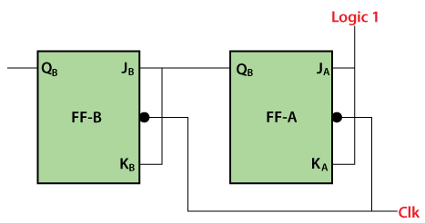
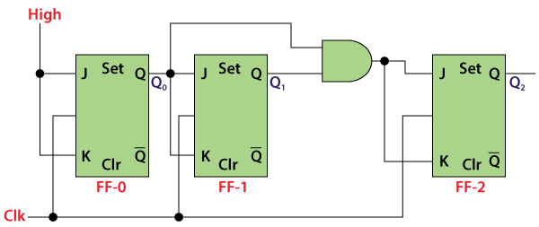
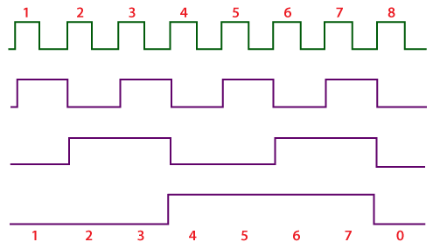

Slide 6
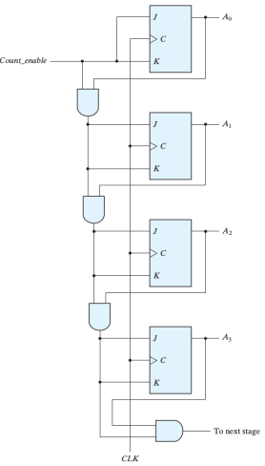
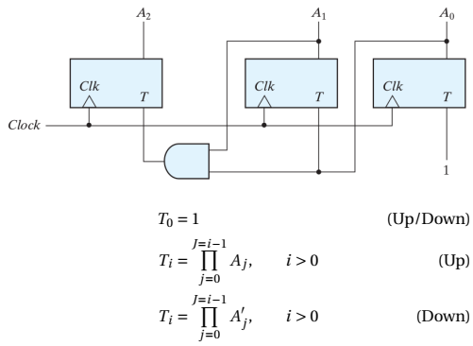
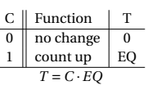
Synchronous Counter
Binary Counter

Slide 7
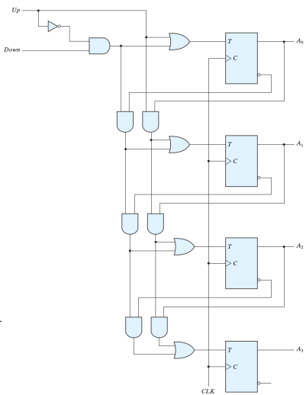
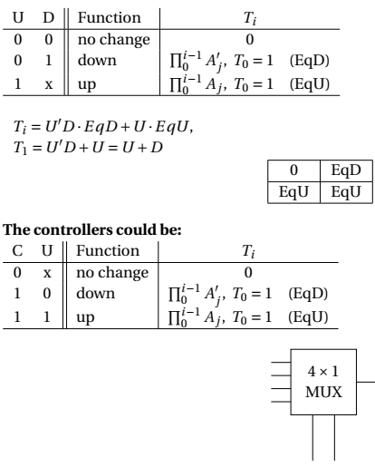
Up-down Binary Counter

Slide 8
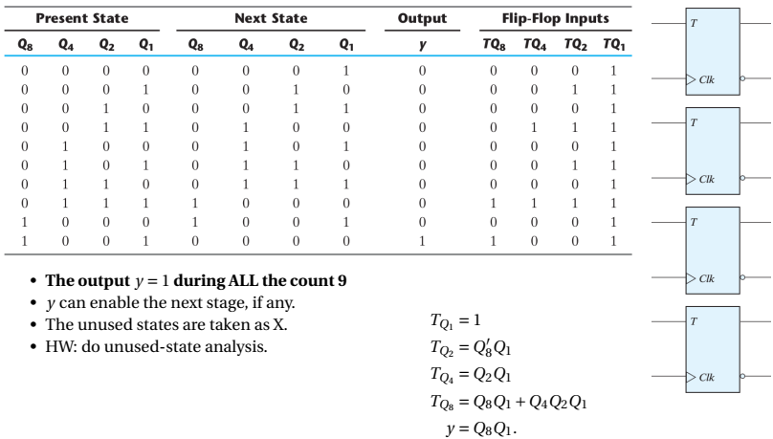
BCD Counter

Slide 9
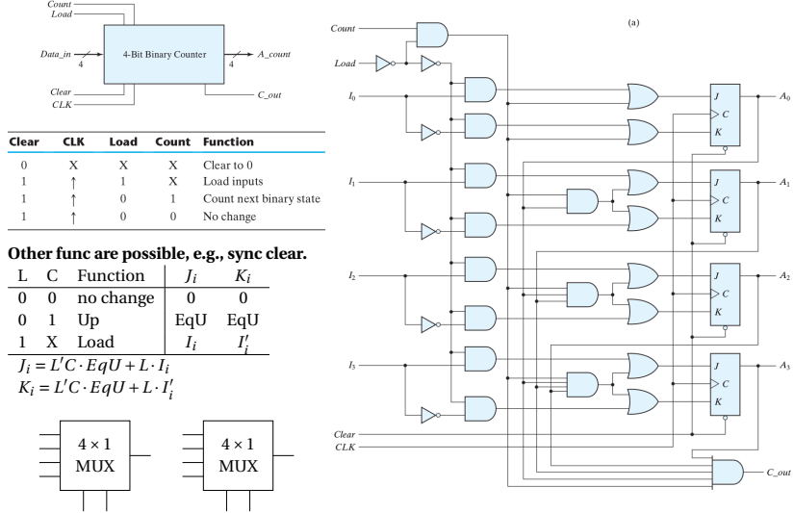
Binary Counter with parallel Load

Slide 10
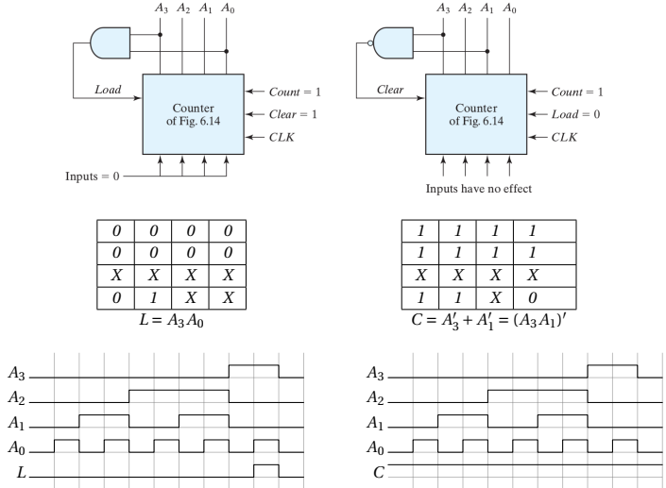
Design a BCD Counter using the Binary Counter with parallel load

Slide 11
Designing procedure of Synchronous Mod-N Counters
Step-1: Determine the number of flip-flops.
The number of flip-flops required to design a mod-N synchronous counter can be determined by using the equation 2^{n} >= N, where n is no. of flip-flops and N is Mod number.
Step-2: Determine the type of flip-flop required ( JK, D, or T flip-flops.)
Step-3: Draw the state diagram which demonstrates the states which the counter undergoes.
Step-4: Using the excitation table of the flip-flop, obtain the flip-flop inputs for each state which were obtained in the second step, and enter them in a table. The flip-flop inputs, that are capable of producing the next state of the counter from the present state, are entered in the table.
Step-5: Make a K-Map for each input combination and simplify it to obtain the minimal Boolean expression for each flip-flop input.
Step-6: Using the Boolean expressions obtained in step 5, draw the required counter circuit by connecting the flip-flops and other gates as per the obtained Boolean expression.

Slide 12
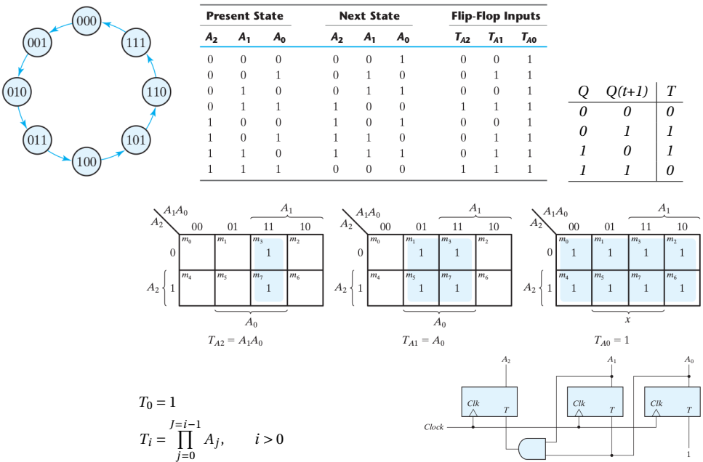
Using a T FF, design a circuit that counts from 0 to 7 compare to D and JK

Slide 13
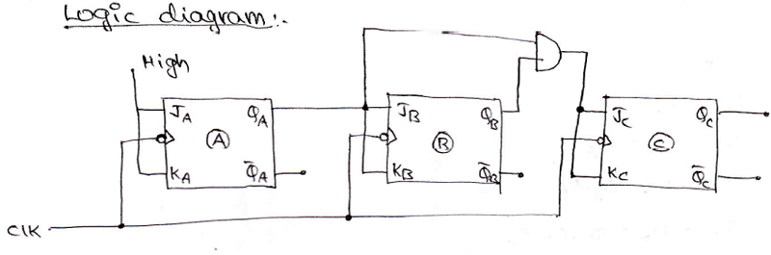

Slide 14
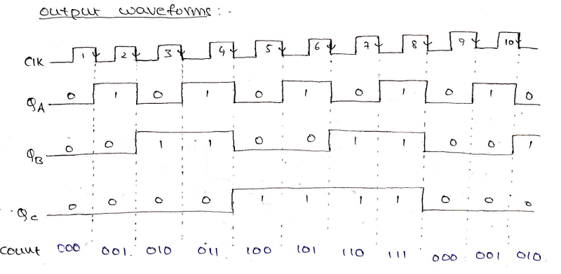

Slide 15
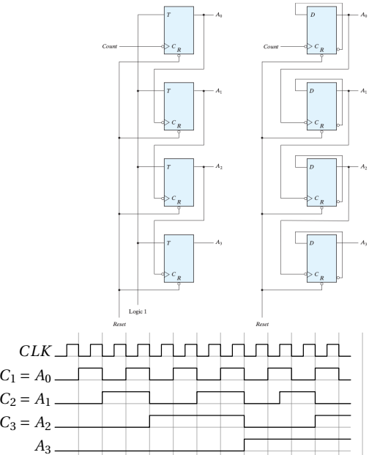
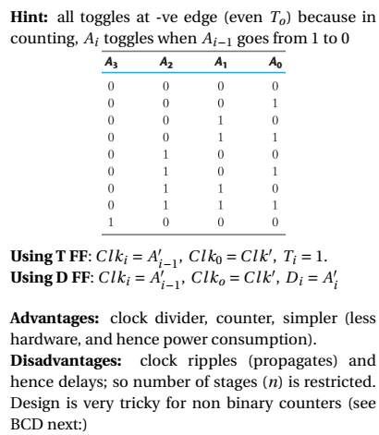
Ripple Counters
Binary Ripple Counter

Slide 16
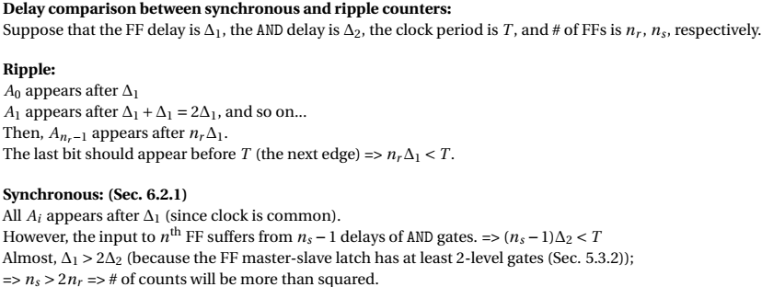

Slide 17
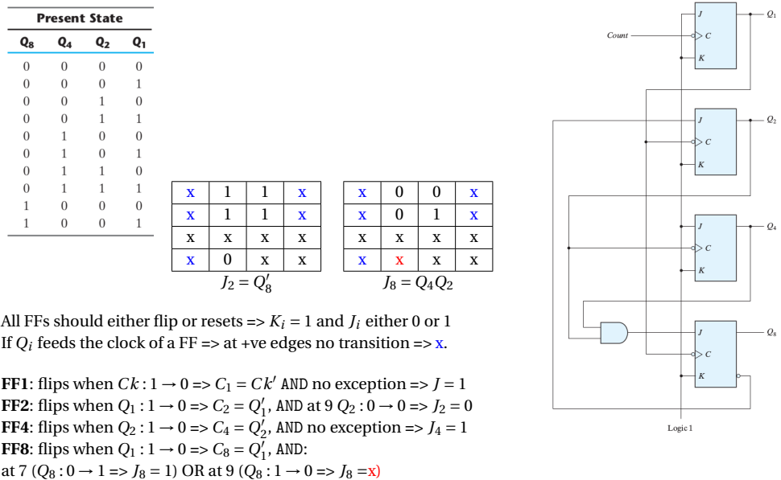
BCD Ripple Counter

Slide 18
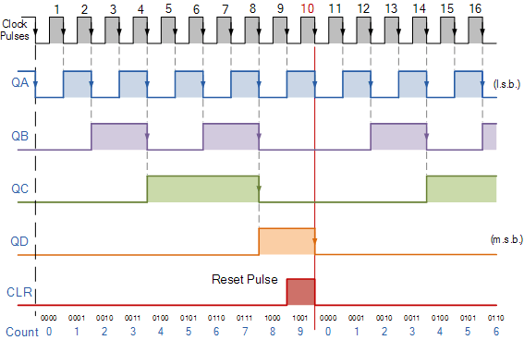

Slide 19
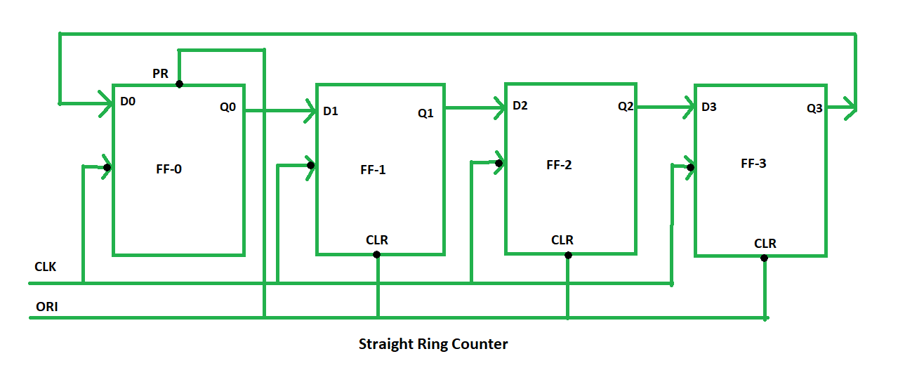
Ring counter is a typical application of Shift resister. Ring counter is almost same as the shift counter. The only change is that the output of the last flip-flop is connected to the input of the first flip-flop in case of ring counter but in case of shift resister it is taken as output. Except this all the other things are same.
No. of states in Ring counter = No. of flip-flop used
Two types of Ring Counter:
1. Straight ring counter or One-hot counter

Slide 20
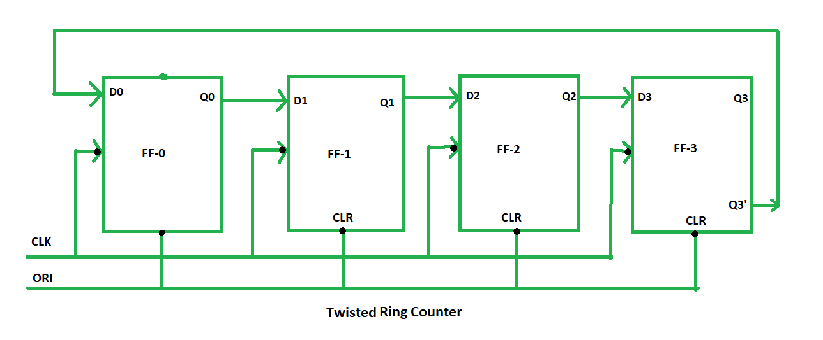
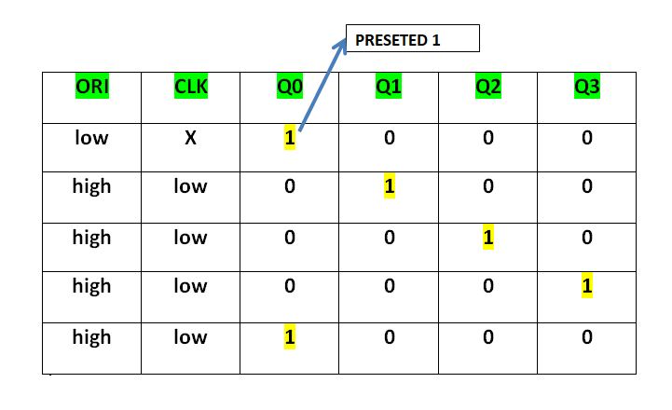
2. Twisted ring or switch-tail ring or walking ring or Johnson or creeping or mobile counter

Slide 21
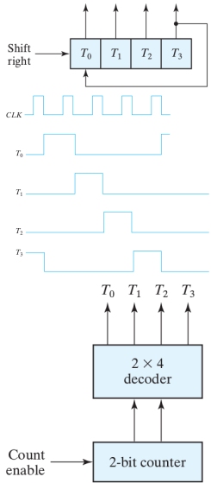
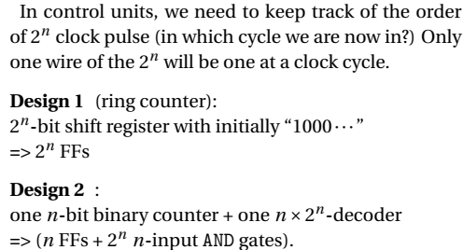
Ring Counters

Slide 22
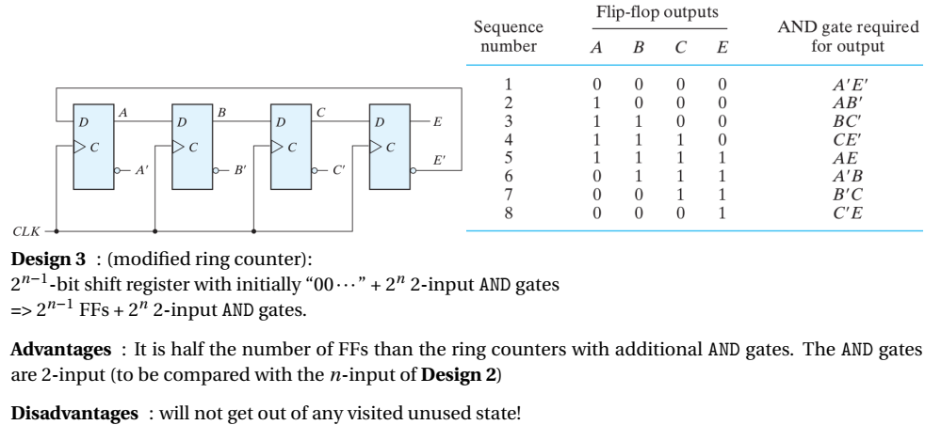
Johnson Counters

Slide 23
Advantages of Johnson counter:
The Johnson counter has same number of flip flop but it can count twice the number of states the ring counter can count.
It can be implemented using D and JK flip flop.
Johnson ring counter is used to count the data in a continuous loop.
Johnson counter is a self-decoding circuit.
Disadvantages of Johnson counter:
Johnson counter doesn’t count in a binary sequence.
In Johnson counter more number of states remain unutilized than the number of states being utilized.
The number of flip flops needed is one half the number of timing signals.
It can be constructed for any number of timing sequence.
Applications of Johnson counter:
Johnson counter is used as a synchronous decade counter or divider circuit.
It is used in hardware logic design to create complicated Finite states machine. ex: ASIC and FPGA design.
The 3 stage Johnson counter is used as a 3 phase square wave generator which produces 1200 phase shift.
It is used to divide the frequency of the clock signal by varying their feedback.

Slide 25
Registers
A Register is a collection of flip flops. A flip flop is used to store single bit digital data. For storing a large number of bits, the storage capacity is increased by grouping more than one flip flops. If we want to store an n-bit word, we have to use an n-bit register containing n number of flip flops.
The register is used in the CPU to perform different types of operations.
Fetch:
To take the instructions given by the users.
To fetch the instruction stored into the main memory.
Decode:
To interpret the instructions.
To decode the instructions.
Execute
To store the result produced by the CPU into the memory.
Results is displayed on the user screen.

Slide 26
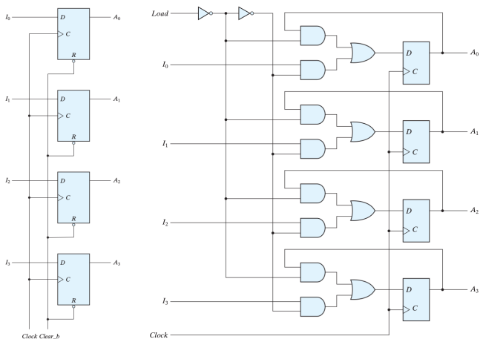
Registers(n-bits, with parallel load)

Slide 27
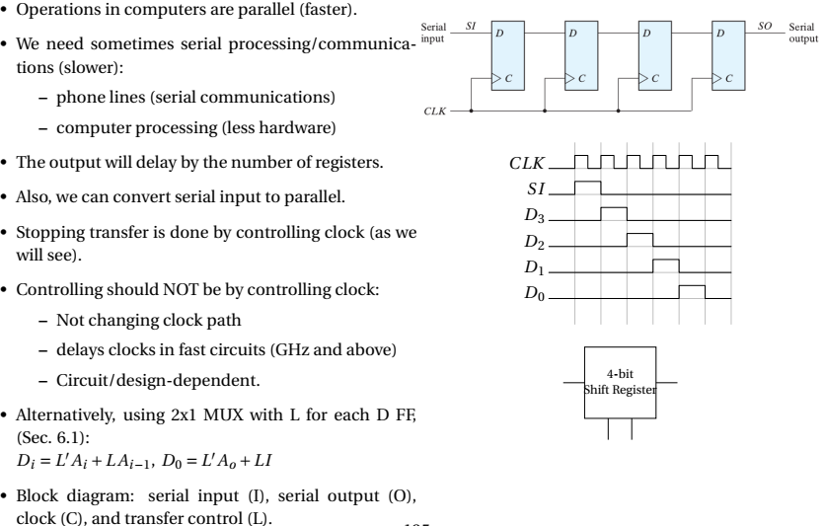
Shift Registers

Slide 28
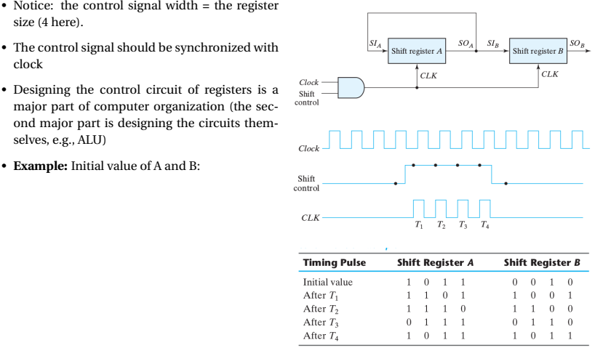
Serial Transfer

Slide 29
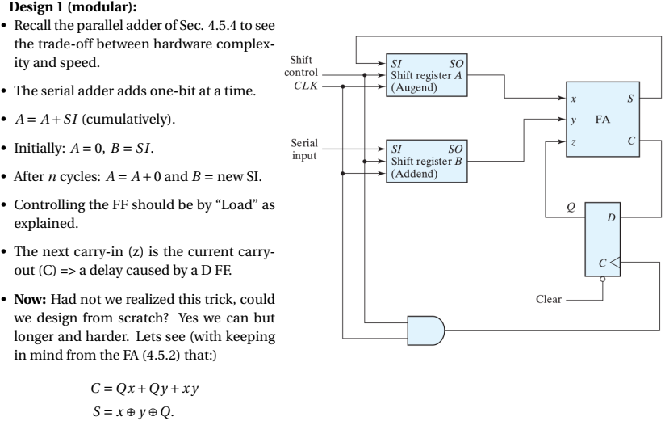
Serial Adder

Slide 30
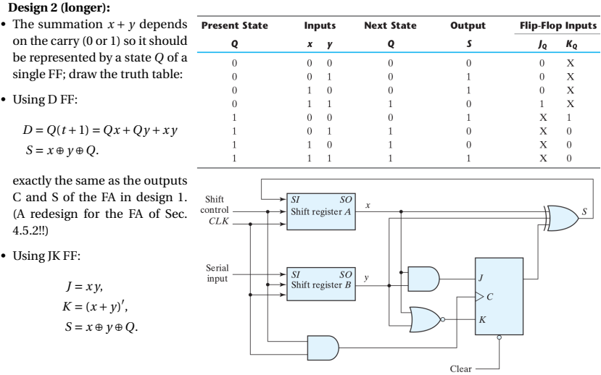

Slide 31
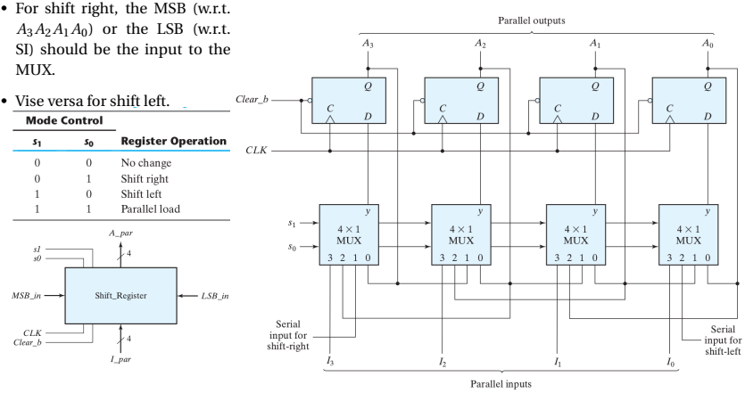
Universal Shift Register

Slide 32
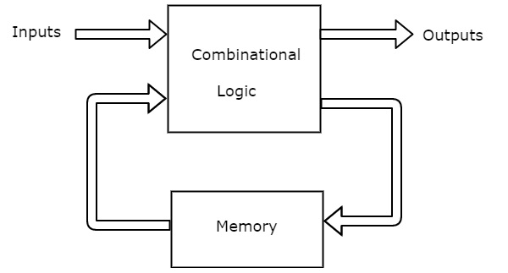
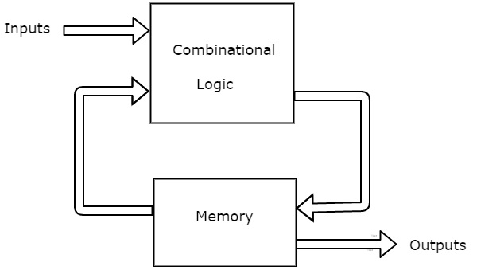
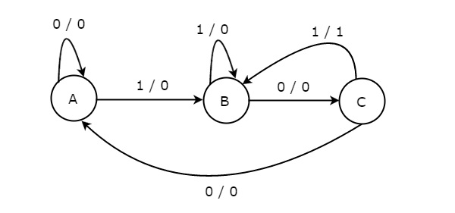
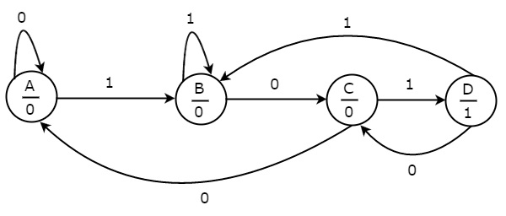
A synchronous sequential circuit is also called as Finite State Machine FSM, if it has finite number of states.
There are two types of FSMs.
Mealy State Machine
outputs depend on both present inputs & present states
Moore State Machine
outputs depend only on present states

Slide 33
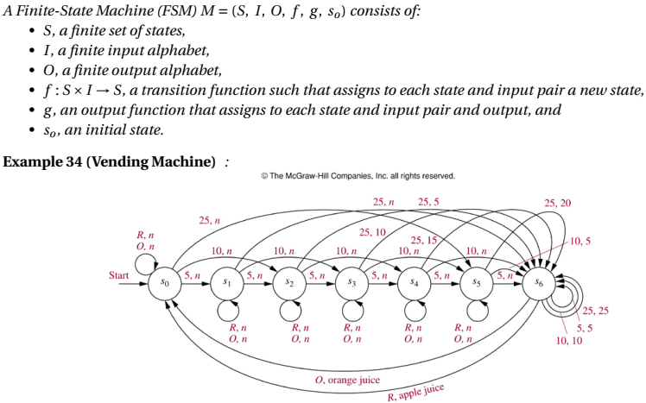
FSM

Slide 34
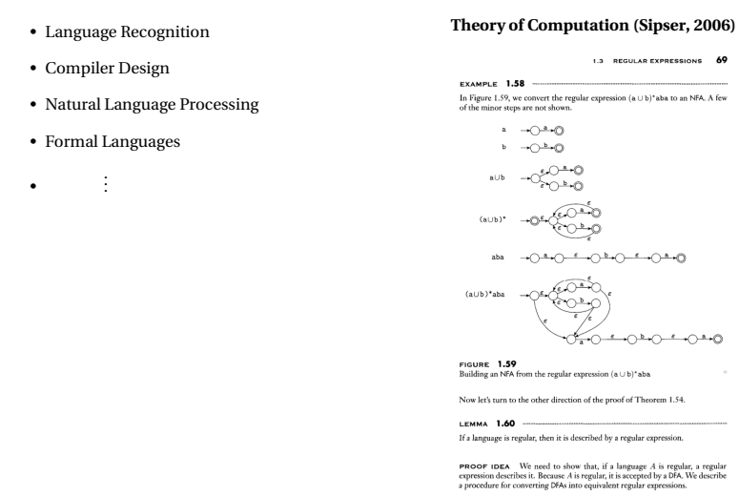
FSM and Languages

Slide 35
A sequence detector is a sequential state machine that takes an input string of bits and generates an output 1 whenever the target sequence has been detected.
Sequence detector is of two types:
Overlapping
the last bit of one sequence becomes the first bit of the next sequence.
Non overlapping
the last bit of one sequence does not become the first bit of the next sequence

Slide 36
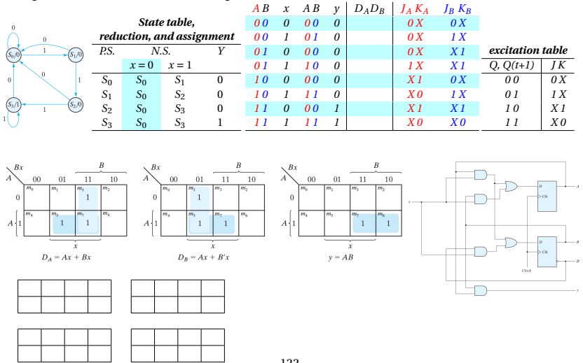
Detect 3 ones in a row (overlap)

Slide 37
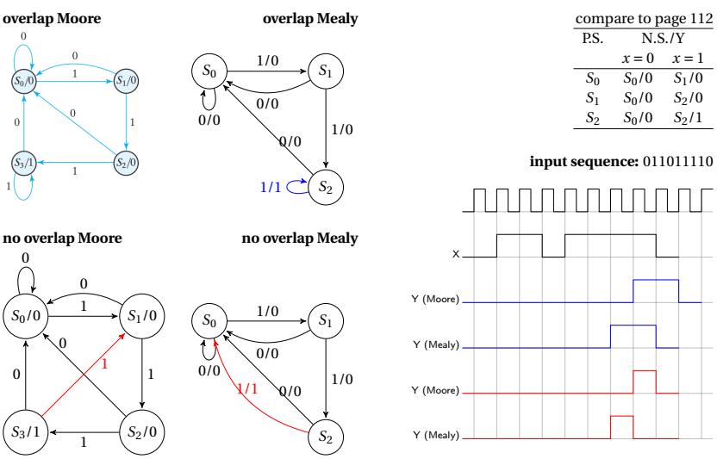
Detect 3 ones in row (with/without overlap) both Moore and Mealy

Slide 38
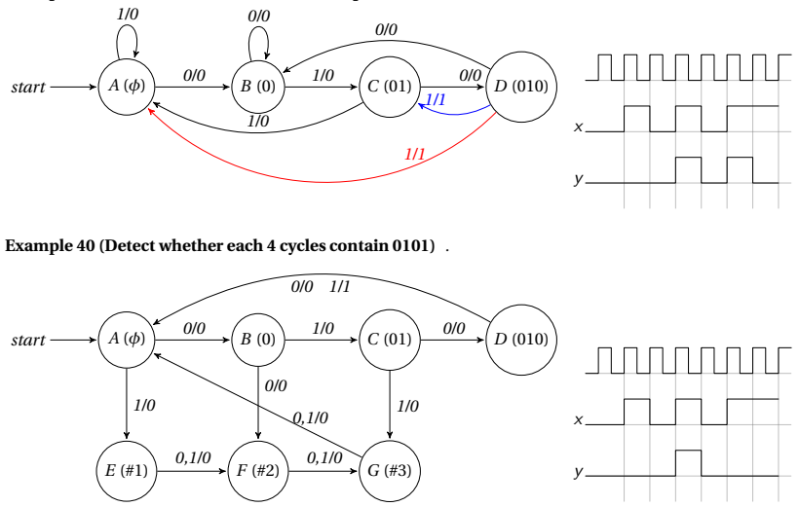
Ex Detect 0101 with/without overlap

